Slide 1

Final Project Semi-Supervised Learning with K-Means and Support Vector Machines
PE 5970 Data Mining for Petroleum Engineers
113102152
Jiwon Jeon

Slide 2
Objectives
Classify Adam Southwest (ASW) well logs by its core-based facies and predict the clusters of non-cored well logs using Semi-Supervised Learning method:
K-Means + Support Vector Machines
Classify ASW well logs to identify its log-based facies and predict the electrofacies of non-cored well logs based on the log-only classification
Compare the clustering results

Slide 3
K-Means and Support Vector Machines (SVM)
K-Means Clustering
Unsupervised learning method using pre-defined # of clusters
Randomly chosen centroids determines the cluster of each data point until convergence is reached.
Limited to linearly related data set.
Support Vector Machines (SVM)
Semi-supervised learning method with training data set to predict the clusters of new data
Support vectors (Maximum margin classifiers) determine the hyperplanes which classify the data points.
Applied to non-linear data set.

Slide 4
Learning Procedure
STEP 1
Train ASW core data to classify petrofacies: K-Means Clustering
STEP 2
Assign core-based facies to ASW log data
STEP 3
Train ASW log data with the core-based facies: SVM
STEP 4
Test non-cored well logs to identify corresponding facies: SVM
STEP 5
Repeat STEPs with log-only classification

Slide 5
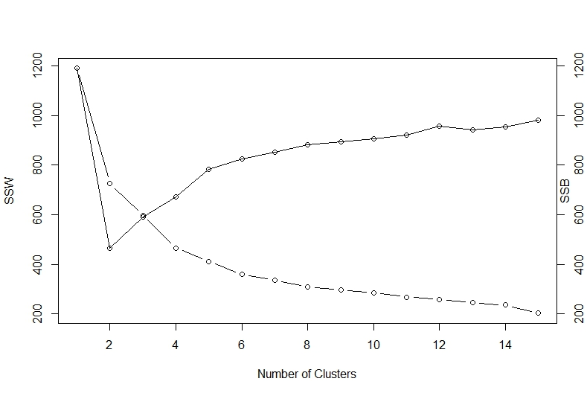
Results – STEP 1
From SSW and SSB plots, optimal number of clusters is chosen to be 4.
Lithofacies of ASW core data are determined by K-Means clustering using following attributes, which are assumed linearly related;
Corrected porosity, TOC, Quartz, Calcite, Dolomite, Illite and Mixed Clays
K-Means Clustering outputs;
Lithofacies of ASW;
# | Size | Centroids
 |  | Cor. por | TOC | Quartz | Calcite | Dolomite | Illite | Mixed Clays
1 | 78 | 4.18 | 4.34 | 25.70 | 2.95 | 0.94 | 31.18 | 17.61
2 | 9 | 4.04 | 2.15 | 12.12 | 7.62 | 39.17 | 16.42 | 7.36
3 | 57 | 5.28 | 4.18 | 41.16 | 5.62 | 1.05 | 22.50 | 8.29
4 | 27 | 2.57 | 1.25 | 10.11 | 52.27 | 2.92 | 8.94 | 1.44
Depth | Cor.por | TOC | Quartz | Calcite | Dolomite | Illite | Mixed. Clays | facies
6432.5 | 6.67 | 4.15 | 38.6 | 0 | 0 | 25.7 | 14.7 | 3
6434.5 | 6.07 | 4.25 | 48.6 | 6.2 | 0 | 20.4 | 3.9 | 3
6436.5 | 4.91 | 3.4 | 41 | 2.5 | 0 | 27.7 | 12.4 | 3
6438.5 | 6 | 0.39 | 4.6 | 66.4 | 0 | 5 | 0 | 4
6440.6 | 5.63 | 3.9 | 37 | 0.6 | 1.2 | 23.5 | 8.9 | 3
… | … | … | … | … | … | … | … | …
6780.6 | 4.16 | 2.47 | 16 | 8.7 | 0.6 | 28.3 | 19 | 1
6782.2 | 2.49 | 2.32 | 24.8 | 19.8 | 3.9 | 27 | 12.6 | 1
6784.3 | 2.99 | 3.66 | 20.2 | 11.9 | 0 | 25.8 | 12.4 | 1
6794 | 6.28 | 0.11 | 0 | 0 | 87.2 | 5.4 | 0 | 2

Slide 6
Results – STEP 2
Lithofacies of ASW core data are assigned to ASW log data by corresponding depth;
*MS Excel Vlookup function is used for this alignment.
**Five attributes, PEF, RHOB, NPHI, GR and AT90, are used as log data. (common features in non-cored well logs)
Depth | Cor.por | TOC | Quartz | Calcite | Dolomite | Illite | Mixed. Clays | facies | PEF | RHOB | NPHI | GR | AT90
6432.5 | 6.67 | 4.15 | 38.6 | 0 | 0 | 25.7 | 14.7 | 3 | 3.661 | 2.3126 | 0.1838 | 120.5496 | 67.1664
6434.5 | 6.07 | 4.25 | 48.6 | 6.2 | 0 | 20.4 | 3.9 | 3 | 3.4846 | 2.4341 | 0.2206 | 133.4917 | 88.7391
6436.5 | 4.91 | 3.4 | 41 | 2.5 | 0 | 27.7 | 12.4 | 3 | 3.0076 | 2.488 | 0.2204 | 144.73 | 37.8431
6438.5 | 6 | 0.39 | 4.6 | 66.4 | 0 | 5 | 0 | 4 | 2.9624 | 2.5127 | 0.1691 | 109.9793 | 148.4039
6440.6 | 5.63 | 3.9 | 37 | 0.6 | 1.2 | 23.5 | 8.9 | 3 | 3.0933 | 2.5511 | 0.1741 | 118.2356 | 96.9911
6442.5 | 5.85 | 3.95 | 40.6 | 2.7 | 0 | 21 | 7.7 | 3 | 3.8576 | 2.6153 | 0.1514 | 159.3088 | 63.0493
6444.5 | 0.88 | 3.5 | 29.3 | 5.5 | 0 | 29.1 | 14.9 | 1 | 3.353 | 2.551 | 0.1774 | 155.5858 | 77.9386
6446.5 | 6.14 | 4.12 | 43.1 | 10 | 0 | 19.7 | 4.4 | 3 | 3.1526 | 2.514 | 0.1967 | 142.1812 | 63.2245
6448.4 | 5.27 | 3.61 | 33.7 | 21.9 | 0 | 22 | 1 | 3 | 3.581 | 2.6069 | 0.1517 | 122.8189 | 121.7389
… | … | … | … | … | … | … | … | … | … | … | … | … | …
6765 | 4.39 | 2.78 | 21.6 | 7.9 | 23 | 22.4 | 10 | 2 | 3.3716 | 2.5746 | 0.1368 | 213.0096 | 353.1487
6769.1 | 3.46 | 2.91 | 29.3 | 7.6 | 9.6 | 26.5 | 13.5 | 1 | 3.8256 | 2.6567 | 0.094 | 143.7786 | 310.7026
6771.8 | 3.86 | 1.53 | 43.1 | 7.8 | 0 | 28.7 | 9.8 | 3 | 3.5593 | 2.5665 | 0.1516 | 201.0151 | 221.7001
6773.9 | 3.77 | 2.06 | 26.7 | 15.4 | 2 | 28.4 | 11.5 | 1 | 3.6951 | 2.5963 | 0.1196 | 171.8287 | 175.9243
6775.1 | 4.6 | 3.52 | 31 | 0 | 1.6 | 33.9 | 11.8 | 1 | 3.5884 | 2.602 | 0.1382 | 183.6014 | 142.4422
6780.6 | 4.16 | 2.47 | 16 | 8.7 | 0.6 | 28.3 | 19 | 1 | 3.4398 | 2.578 | 0.1477 | 231.5359 | 338.1531
6782.2 | 2.49 | 2.32 | 24.8 | 19.8 | 3.9 | 27 | 12.6 | 1 | 3.9544 | 2.6123 | 0.1235 | 196.2101 | 253.416
6784.3 | 2.99 | 3.66 | 20.2 | 11.9 | 0 | 25.8 | 12.4 | 1 | 3.6779 | 2.6644 | 0.1176 | 185.5056 | 45.481
6794 | 6.28 | 0.11 | 0 | 0 | 87.2 | 5.4 | 0 | 2 | 4.7553 | 2.7672 | 0.0819 | 215.6454 | 10.3764

Slide 7
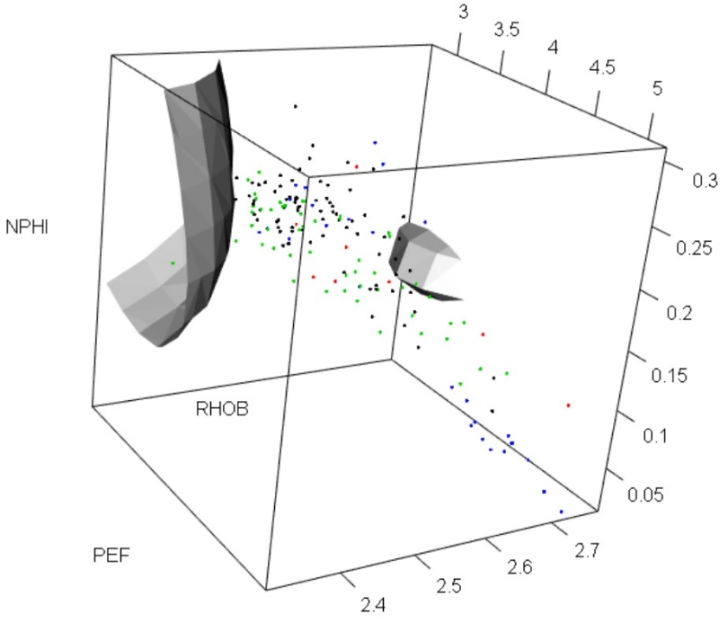
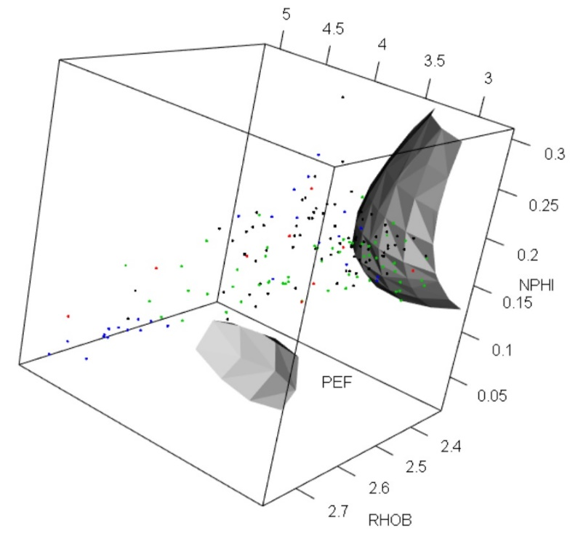
Results – STEP 3
In this step, ASW log data are trained with lithofacies determined in STEP 1.
To incorporate the non-linearity of log data, multinary SVM technique is used.
Radial Kernel transformation is applied to the SVM training;
Cost = 10 & Gamma = 0.1
3D plots of SVM training shows the hyperplanes of Radial Kernel transformation;

Slide 8
Results – STEP 4
Non-cored wells, 42497365690009 and 42497368240009, are chosen to test and predict the clusters by the multinary SVM model in STEP 3.
These wells are selected because they are located in the same county of ASW, Wise (497), which is expected to deliver a meaningful classification.
Test results;
42497365690009
DEPTH | PEF | RHOB | NPHI | GR | AT90 | Facies - Pred
5978.5 | 10 | 3.35 | 0.078 | 44.405 | 41.01 | 3
5979 | 10 | 3.35 | 0.078 | 45.448 | 41.01 | 3
… | … | … | … | … | … | …
6768 | 3.8 | 2.556 | 0.227 | 216.259 | 446.962 | 1
6768.5 | 3.774 | 2.568 | 0.228 | 210.093 | 318.409 | 1
6769 | 3.752 | 2.599 | 0.205 | 183.779 | 260.721 | 1
… | … | … | … | … | … | …
6846.5 | 3.062 | 2.533 | 0.253 | 67.251 | 0.742 | 4
6847 | 3.018 | 2.566 | 0.248 | 63.161 | 0.893 | 4
6847.5 | 3.025 | 2.606 | 0.223 | 57.109 | 1.165 | 4
… | … | … | … | … | … | …
6879 | 3.537 | 2.802 | 0.034 | 39.857 | 12.145 | 3
6879.5 | 3.509 | 2.804 | 0.033 | 41.779 | 12.377 | 3
6880 | 3.488 | 2.804 | 0.035 | 40.961 | 15.437 | 3
42497368240009
DEPTH | PEF | RHOB | NPHI | GR | AT90 | Facies - Pred
6200 | 3.293 | 2.532 | 0.199 | 89.742 | 7.773 | 3
6200.5 | 3.324 | 2.529 | 0.203 | 92.166 | 7.254 | 3
… | … | … | … | … | … | …
6212 | 4.802 | 2.453 | 0.185 | 89.546 | 10.005 | 4
6212.5 | 4.735 | 2.475 | 0.195 | 90.125 | 11.396 | 4
6213 | 4.512 | 2.515 | 0.193 | 90.654 | 11.114 | 1
6213.5 | 4.189 | 2.55 | 0.162 | 92.294 | 11.767 | 1
6214 | 3.914 | 2.553 | 0.119 | 94.799 | 14.329 | 3
… | … | … | … | … | … | …
7484 | 6.048 | 2.745 | 0.084 | 90.73 | 9.366 | 2
7484.5 | 5.571 | 2.721 | 0.058 | 84.842 | 15.228 | 1
… | … | … | … | … | … | …
7490 | 3.793 | 2.75 | 0.044 | 44.773 | 15.563 | 3
7490.5 | 3.741 | 2.736 | 0.063 | 45.841 | 15.563 | 3

Slide 9
Results – STEP 5
Electrofacies of ASW log data are determined by K-Means clustering, and non-cored well logs are tested by SVM for classification.
Here, well 42497365690009 is used for log-only classification.
K-Means clustering provides the following sizes;
Test results;
Note
Clustering from core based SVM and log-only SVM shows 40.02% match for facies classification.
As K-Means clustering gives different classification result every iteration, the core-based clustering and log-only classification do not provide apple-to-apple comparison.
42497365690009
DEPTH | PEF | RHOB | NPHI | GR | AT90 | Facies - Pred
5978.5 | 10 | 3.35 | 0.078 | 44.405 | 41.01 | 3
5979 | 10 | 3.35 | 0.078 | 45.448 | 41.01 | 3
… | … | … | … | … | … | …
6768 | 3.8 | 2.556 | 0.227 | 216.259 | 446.962 | 4
6768.5 | 3.774 | 2.568 | 0.228 | 210.093 | 318.409 | 4
6769 | 3.752 | 2.599 | 0.205 | 183.779 | 260.721 | 4
… | … | … | … | … | … | …
6846.5 | 3.062 | 2.533 | 0.253 | 67.251 | 0.742 | 4
6847 | 3.018 | 2.566 | 0.248 | 63.161 | 0.893 | 4
6847.5 | 3.025 | 2.606 | 0.223 | 57.109 | 1.165 | 4
… | … | … | … | … | … | …
6879 | 3.537 | 2.802 | 0.034 | 39.857 | 12.145 | 2
6879.5 | 3.509 | 2.804 | 0.033 | 41.779 | 12.377 | 2
6880 | 3.488 | 2.804 | 0.035 | 40.961 | 15.437 | 2
Facies | 1 | 2 | 3 | 4
Size | 769 | 492 | 50 | 755

